Slide 1
Graphs +
Topological sort
Thanks to David Kauchak

Slide 2
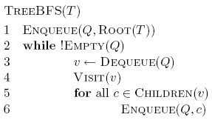
Tree BFS

Slide 3
Running time of Tree BFS
Adjacency list
  How many times does it visit each vertex?
  How many times is each edge traversed?
  O(|V|+|E|)
Adjacency matrix
  For each vertex visited, how much work is done?
  O(|V|²)

Slide 4
BFS Recursively
Hard to do!

Slide 5
BFS for graphs
What needs to change for graphs?
Need to make sure we don’t visit a node multiple times
C
A
B
F
G
D
E

Slide 6
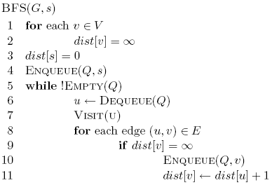
distance variable keeps track of how far from the starting node and whether we’ve seen the node yet
C
A
B
F
G
D
E

Slide 7
C
A
B
F
G
D
E

Slide 8
set all nodes as unseen
C
A
B
F
G
D
E

Slide 9
check if the node has been seen
C
A
B
F
G
D
E

Slide 10
set the node as seen and record distance
C
A
B
F
G
D
E

Slide 11
∞
C
∞
∞
A
B
∞
∞
F
G
∞
∞
D
E

Slide 12
Q: A
∞
C
0
∞
A
B
∞
∞
F
G
∞
∞
D
E

Slide 13
Q:
∞
C
0
∞
A
B
∞
∞
F
G
∞
∞
D
E

Slide 14
Q: D, E, B
∞
C
0
1
A
B
∞
∞
F
G
1
1
D
E

Slide 15
Q: E, B
∞
C
0
1
A
B
∞
∞
F
G
1
1
D
E

Slide 16
Q: B
∞
C
0
1
A
B
∞
∞
F
G
1
1
D
E

Slide 17
Q: B
∞
C
0
1
A
B
∞
∞
F
G
1
1
D
E

Slide 18
Q:
∞
C
0
1
A
B
∞
∞
F
G
1
1
D
E

Slide 19
Q:
∞
C
0
1
A
B
∞
∞
F
G
1
1
D
E

Slide 20
Q: F, C
2
C
0
1
A
B
2
∞
F
G
1
1
D
E

Slide 21
2
C
0
1
A
B
2
3
F
G
1
1
D
E

Slide 22
2
C
0
1
A
B
2
3
F
G
1
1
D
E

Slide 23
2
C
0
1
A
B
2
3
F
G
1
1
D
E

Slide 24
Is BFS correct?
Does it visit all nodes reachable from the starting node?
Can you prove it?
Assume we “miss” some node ‘u’, i.e. a path exists, but we don’t visit ‘u’
S
…
U

Slide 25
Is BFS correct?
Does it visit all nodes reachable from the starting node?
Can you prove it?
Find the last node along the path to ‘u’ that was visited
S
…
Z
W
…
U
why do we know that such a node exists?

Slide 26
Is BFS correct?
Does it visit all nodes reachable from the starting node?
Can you prove it?
We visited ‘z’ but not ‘w’, which is a contradiction, given the pseudocode
S
…
Z
W
…
U
contradiction

Slide 27
Is BFS correct?
Does it correctly label each node with the shortest distance from the starting node?

Slide 28
Is BFS correct?
Does it correctly label each node with the shortest distance from the starting node?
Assume the algorithm labels a node with a longer distance. Call that node ‘u’
S
…
U

Slide 29
Is BFS correct?
Does it correctly label each node with the shortest distance from the starting node?
Find the last node in the path with the correct distance
S
…
Z
W
…
U
correct
incorrect

Slide 30
Is BFS correct?
Does it correctly label each node with the shortest distance from the starting node?
Find the last node in the path with the correct distance
S
…
Z
W
…
U
contradiction

Slide 31
Runtime of BFS
Nothing changed over our analysis of TreeBFS

Slide 32
Runtime of BFS
Adjacency list: O(|V| + |E|)
Adjacency matrix: O(|V|²)

Slide 33
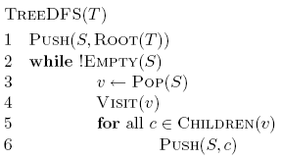
Depth First Search (DFS)

Slide 34
Depth First Search (DFS)

Slide 35
Tree DFS
A
B
D
E
C
F
G

Slide 36
Tree DFS
A
B
D
E
C
F
G

Slide 37
Tree DFS
A
B
D
E
C
F
G

Slide 38
Tree DFS
A
B
D
E
C
F
G

Slide 39
Tree DFS
A
B
D
E
C
F
G
Frontier?

Slide 40
Tree DFS
A
B
D
E
C
F
G

Slide 41
Tree DFS
A
B
D
E
C
F
G

Slide 42
Tree DFS
A
B
D
E
C
F
G

Slide 43
Tree DFS
A
B
D
E
C
F
G

Slide 44
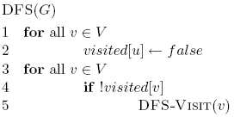
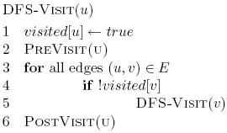
DFS on graphs

Slide 45
DFS on graphs
mark all nodes as not visited

Slide 46
DFS on graphs
until all nodes have been visited repeatedly call DFS-Visit

Slide 47
DFS on graphs
What happened to the stack?

Slide 48
What does DFS do?
Finds connected components
Each call to DFS-Visit from DFS starts exploring a new set of connected components
Helps us understand the structure/connectedness of a graph

Slide 49
Is DFS correct?
Does DFS visit all of the nodes in a graph?

Slide 50
Running time?
Like BFS
  Visits each node exactly once
  Processes each edge exactly twice (for an undirected graph)
  O(|V|+|E|)

Slide 51
DAGs
Can represent dependency graphs
socks
underwear
shoes
pants
shirt
belt
watch
tie
jacket

Slide 52
Topological sort
A linear ordering of all the vertices such that for all edges (u,v) ∈ E, u appears before v in the ordering
An ordering of the nodes that “obeys” the dependencies, i.e. an activity can’t happen until it’s dependent activities have happened
watch
underwear
pants
socks
shirt
underwear
shoes
belt
pants
tie
shirt
socks
belt
watch
tie
shoes
jacket
jacket

Slide 53
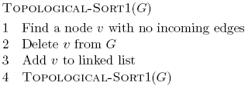
Topological sort

Slide 54
Topological sort
socks
underwear
shoes
pants
shirt
belt
watch
tie
jacket

Slide 55
Topological sort
socks
underwear
shoes
pants
shirt
belt
watch
tie
jacket

Slide 56
Topological sort
underwear
socks
shoes
pants
shirt
belt
watch
tie
jacket

Slide 57
Topological sort
underwear
socks
shoes
pants
shirt
belt
watch
tie
jacket

Slide 58
Topological sort
underwear
pants
socks
shoes
shirt
belt
watch
tie
jacket

Slide 59
Topological sort
underwear
pants
socks
shoes
shirt
belt
watch
tie
jacket

Slide 60
Topological sort
underwear
pants
shirt
socks
shoes
belt
watch
tie
jacket

Slide 61
Topological sort
underwear
pants
shirt
…
socks
shoes
belt
watch
tie
jacket

Slide 62
Running time?

Slide 63
Running time?
O(|V|+|E|)

Slide 64
Running time?
O(E) overall

Slide 65
Running time?
How many calls?
|V|

Slide 66
Running time?
Overall running time?
O(|V|²+|V| |E|)

Slide 67
Can we do better?

Slide 68
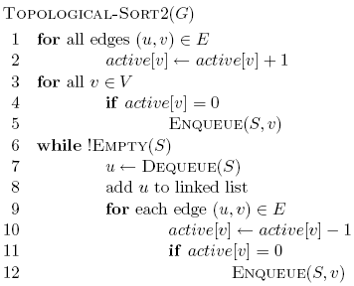
Topological sort 2

Slide 69
Topological sort 2

Slide 70
Topological sort 2

Slide 71
Topological sort 2

Slide 72
Running time?
How many times do we process each node?
How many times do we process each edge?
O(|V| + |E|)

Slide 73
Connectedness
Given an undirected graph, for every node u ∈ V, can we reach all other nodes in the graph?
Run BFS or DFS-Visit (one pass) and mark nodes as we visit them. If we visit all nodes, return true, otherwise false.
Running time:
O(|V| + |E|)

Slide 74
Strongly connected
Given a directed graph, can we reach any node v from any other node u?
Ideas?

Slide 75
Transpose of a graph
Given a graph G, we can calculate the transpose of a graph G^{R} by reversing the direction of all the edges
G^{R}
G
A
A
B
B
D
D
E
E
C
C
Running time to calculate G^{R}?
O(|V| + |E|)

Slide 76
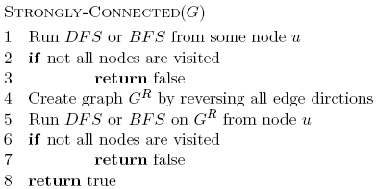
Strongly connected

Slide 77
Is it correct?
What do we know after the first pass?
  Starting at u, we can reach every node
What do we know after the second pass?
  All nodes can reach u. Why?
  We can get from u to every node in G^{R}, therefore, if we reverse the edges (i.e. G), then we have a path from every node to u
Which means that any node can reach any other node. Given any two nodes s and t we can create a path through u
s
…
u
…
t

Slide 78
Runtime?
O(|V| + |E|)
O(|V|)
O(|V| + |E|)
O(|V| + |E|)
O(|V|)
O(|V| + |E|)

Slide 79
Detecting cycles
Undirected graph
  BFS or DFS. If we reach a node we’ve seen already, then we’ve found a cycle
Directed graph
A
B
D
have to be careful

Slide 80
Detecting cycles
Undirected graph
  BFS or DFS. If we reach a node we’ve seen already, then we’ve found a cycle
Directed graph
  Call TopologicalSort
  If the length of the list returned ≠ |V| then a cycle exists

Slide 81
Shortest paths
What is the shortest path from a to d?
B
D
A
C
E

Slide 82
Shortest paths
BFS
B
D
A
C
E

Slide 83
Shortest paths
What is the shortest path from a to d?
2
B
D
3
3
A
1
2
1
C
E
4

Slide 84
Shortest paths
We can still use BFS
2
B
D
3
3
A
1
2
1
C
E
4

Slide 85
Shortest paths
We can still use BFS
2
B
D
B
D
3
3
A
1
2
A
1
C
E
C
E
4

Slide 86
Shortest paths
We can still use BFS
B
D
A
C
E

Slide 87
Shortest paths
What is the problem?
B
D
A
C
E

Slide 88
Shortest paths
Running time is dependent on the weights
B
B
2
100
1
A
50
A
4
C
200
C

Slide 89
Shortest paths
B
B
100
A
50
A
200
C
C

Slide 90
Shortest paths
B
A
C

Slide 91
Shortest paths
B
A
C

Slide 92
Shortest paths
Nothing will change as we expand the frontier until we’ve gone out 100 levels
B
A
C

Slide 93
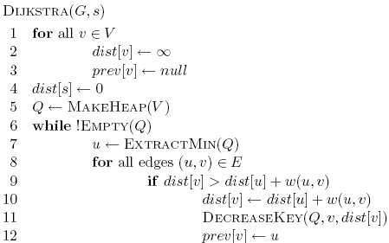
Dijkstra’s algorithm

Slide 94
Dijkstra’s algorithm

Slide 95
Dijkstra’s algorithm
prev keeps track of
the shortest path

Slide 96
Dijkstra’s algorithm

Slide 97
Dijkstra’s algorithm

Slide 98
Dijkstra’s algorithm

Slide 99
3
B
D
3
1
A
1
2
1
C
E
4

Slide 100
∞
∞
3
B
D
3
∞
1
A
1
2
∞
1
C
E
∞
4

Slide 101
Heap
A 0
B ∞
C ∞
D ∞
E ∞
∞
∞
3
B
D
3
0
1
A
1
2
∞
1
C
E
∞
4

Slide 102
Heap
B ∞
C ∞
D ∞
E ∞
∞
∞
3
B
D
3
0
1
A
1
2
∞
1
C
E
∞
4

Slide 103
Heap
B ∞
C ∞
D ∞
E ∞
∞
∞
3
B
D
3
0
1
A
1
2
∞
1
C
E
∞
4

Slide 104
Heap
C 1
B ∞
D ∞
E ∞
∞
∞
3
B
D
3
0
1
A
1
2
1
1
C
E
∞
4

Slide 105
Heap
C 1
B ∞
D ∞
E ∞
∞
∞
3
B
D
3
0
1
A
1
2
1
1
C
E
∞
4

Slide 106
Heap
C 1
B 3
D ∞
E ∞
3
∞
3
B
D
3
0
1
A
1
2
1
1
C
E
∞
4

Slide 107
Heap
C 1
B 3
D ∞
E ∞
3
∞
3
B
D
3
0
1
A
1
2
1
1
C
E
∞
4

Slide 108
Heap
B 3
D ∞
E ∞
3
∞
3
B
D
3
0
1
A
1
2
1
1
C
E
∞
4

Slide 109
Heap
B 3
D ∞
E ∞
3
∞
3
B
D
3
0
1
A
1
2
1
1
C
E
∞
4

Slide 110
Heap
B 3
D ∞
E ∞
3
∞
3
B
D
3
0
1
A
1
2
1
1
C
E
∞
4

Slide 111
Heap
B 2
D ∞
E ∞
2
∞
3
B
D
3
0
1
A
1
2
1
1
C
E
∞
4

Slide 112
Heap
B 2
D ∞
E ∞
2
∞
3
B
D
3
0
1
A
1
2
1
1
C
E
∞
4

Slide 113
Heap
B 2
E 5
D ∞
2
∞
3
B
D
3
0
1
A
1
2
1
1
C
E
5
4

Slide 114
Heap
B 2
E 5
D ∞
2
∞
3
B
D
3
0
1
A
1
2
Frontier?
1
1
C
E
5
4

Slide 115
Heap
B 2
E 5
D ∞
2
∞
3
B
D
3
0
All nodes reachable from starting node within a given distance
1
A
1
2
1
1
C
E
5
4

Slide 116
Heap
E 3
D 5
2
5
3
B
D
3
0
1
A
1
2
1
1
C
E
3
4

Slide 117
Heap
D 5
2
5
3
B
D
3
0
1
A
1
2
1
1
C
E
3
4

Slide 118
Heap
2
5
3
B
D
3
0
1
A
1
2
1
1
C
E
3
4

Slide 119
Heap
2
5
3
B
D
0
1
A
1
1
1
C
E
3

